Slide 1
Welcome to the Web Application Development with Python L-4 Training Program

Slide 2
MD. SHAKIL Asst. Trainer Web Application Development with Python Daffodil International Professional Training Institute Cell: +880 1793-299882 Email: shakil.eub.cse@gmail.com

Slide 3
HTML
Lecture
All About HTML
01

Slide 4
Commonly Used Tags in HTML

Slide 5
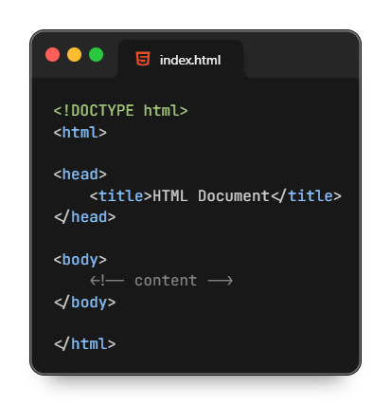
Document Structure of HTML Page
<!DOCTYPE html> tag specifies that the document is an HTML5 document.
<html lang="en"> tag defines the document to be in English.
<head> section contains metadata and the title of the webpage, which appears in the browser's title bar.
<body> section contains the content that will be displayed on the webpage.

Slide 6
Meta Tags
<title> </title>: Sets the title of the web page.
<meta>: Provides metadata such as character set, author, and viewport settings.
<link>: Links external resources like stylesheets.

Slide 7
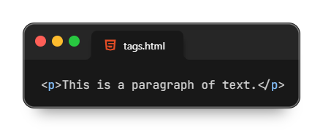
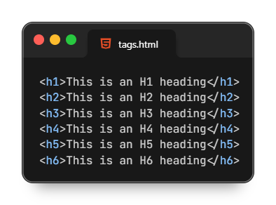
Test Formatting Tags
<p> </p>: Paragraph
<h1> </h1>, <h2> </h2>, <h3>, <h4> </h4>, <h5> </h5>, <h6> </h6>: Headings

Slide 8
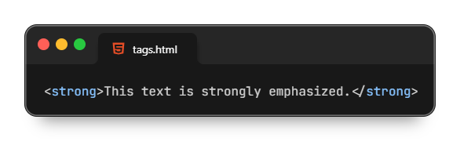
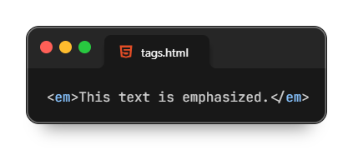
Test Formatting Tags
<strong> </strong>: Strong emphasis (typically bold)
<b> </b>: Bold

Slide 9
Test Formatting Tags
<em></em>: Emphasis (typically italic)
<u> </u>: Underline
<i> </i>: Italic
<br>: Line break

Slide 10
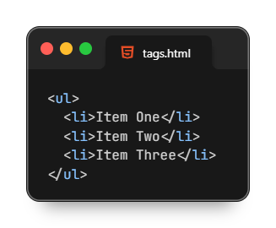
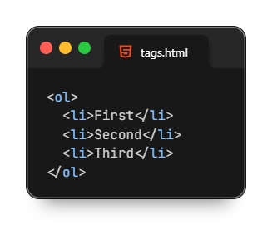
List Tags
<ul> </ul>: Unordered list.
<ol> </ol>: Ordered list.
<li> </li>: List item.

Slide 11
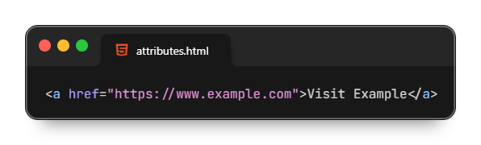
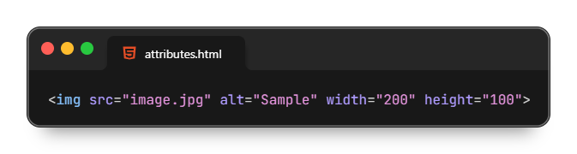
Hyperlink and Media Tags
<a></a>: Anchor (Creates a hyperlink to another web page, location, or file.)
<img>: image (Embeds an image into the web page.)

Slide 12
HTML
Lecture
All About HTML
02

Slide 13
Table Tags
<table>: Table
<tr>: Table row
<td>: Table data cell
<th>: Table header cell
<thead>: Table header group
<tbody>: Table body group
<tfoot>: Table footer group

Slide 14
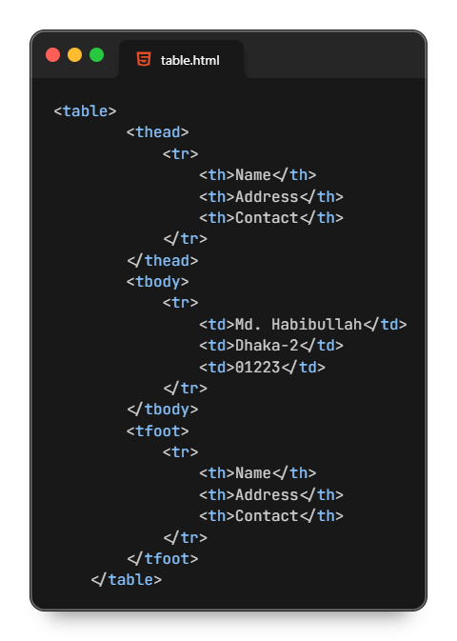
Table Tags Example

Slide 15
Form Tags
<input>: Input field
<textarea>: Text area
<button>: Button
<select>: Dropdown list
<option>: Options within a <select> or <datalist>
<form>: Form

Slide 16
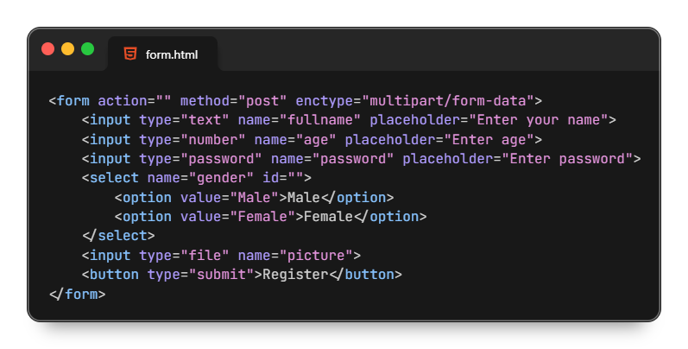
Form Tags Example

Slide 17
Semantic Tags
<header>: Header section
<footer>: Footer section
<article>: Article
<section>: Section
<nav>: Navigation
<aside>: Sidebar content

Slide 18
Types of HTML Elements

Slide 19
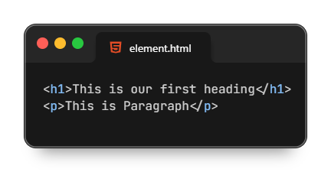
HTML Element?
An HTML element is a complete set that consists of a start tag (or opening tag), content, and an end tag (or closing tag).
HTML Element = Start Tag + Content + End Tag

Slide 20
Nested HTML Element
A nested HTML element is an HTML structure where one element is placed inside another element.

Slide 21
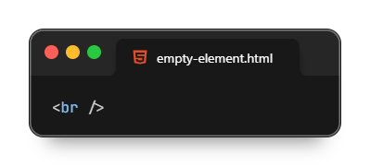
Empty HTML Element
An empty HTML element is one that does not have a closing tag or content. These elements are also known as "void elements" or "self-closing elements."

Slide 22
Some HTML Attributes

Slide 23
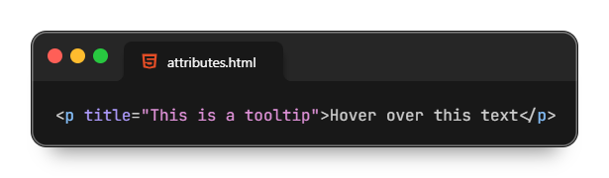
The href attribute of <a> specifies the URL of the page the link goes to
The src, alt, width and height attribute of <img> specifies the path to the image to be displayed
The title attribute defines some extra information about an element

Slide 24
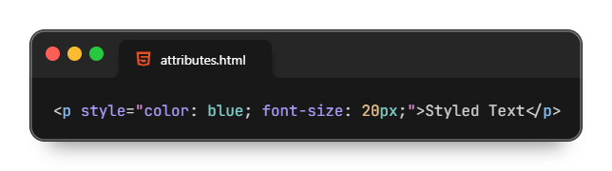
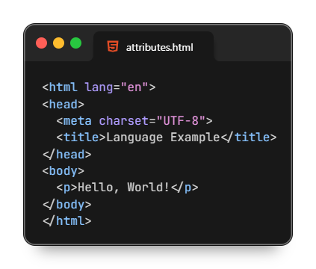
The style attribute is used to add styles to an element, such as color, font, size, and more
The lang attribute of the <html> tag declares the language of the Web page

Slide 25
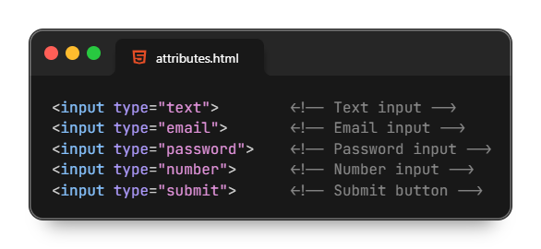
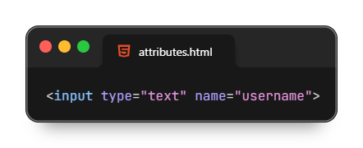
The type attribute of <input> specifies the type of input control
The name attribute of <input>, <select>, <textarea> specifies the name of the input, used when submitting form data.

Slide 26
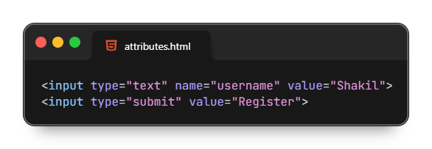
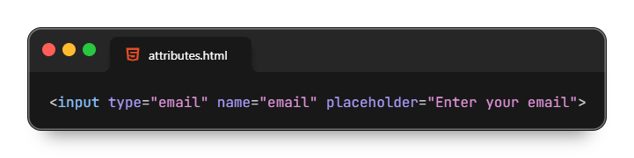
The value attribute of <input>, <button> Defines the default or pre-filled value of the input or button label.
The placeholder attribute of <input>, <textarea> shows hint text in the input box

Slide 27
Thanks All

